Slide 1

ANÁLISIS DE DATOS ESPACIALES
EDIER V. ARISTIZÁBAL G.
Ing. Geólogo (Universidad Nacional de Colombia)
Esp. en Gestión de Riesgos Geológicos (Universidad de Ginebra – Suiza)
MSc. en Geociencias (Universidad de Shimane – Japón)
PhD. en Ingeniería (Universidad Nacional de Colombia)
Universidad Nacional de Colombia
Facultad de Minas
Departamento de Geociencias

Slide 2
The features you use influence more than everything else the result. No algorithm alone, to my knowledge, can supplement the information gain given by correct feature engineering.
— Luca Massaron

Slide 3

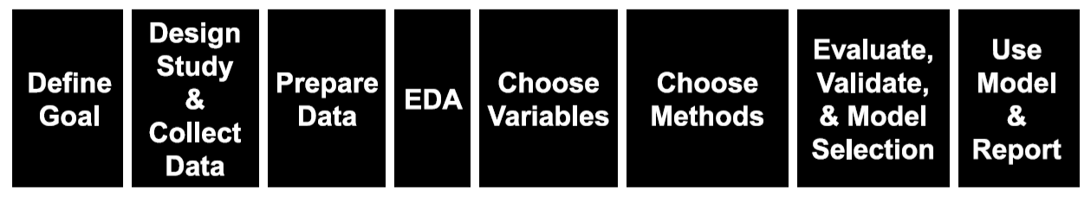
PROCEDIMIENTO GENERAL
Handling missing values
Correlation
Outlier detection
Data partitioning
Scaling
Unbalanced data
Label & one-hot encoding

Slide 4
FEATURE ENGINEERING
“Feature engineering is the process of transforming raw data into features that better represent the underlying problem to the predictive models, resulting in improved model accuracy on unseen data.”
— Dr. Jason Brownlee
Feature engineering mainly have two goals:
Preparing the proper input dataset, compatible with the machine learning algorithm requirements.
Improving the performance of machine learning models.

Slide 5
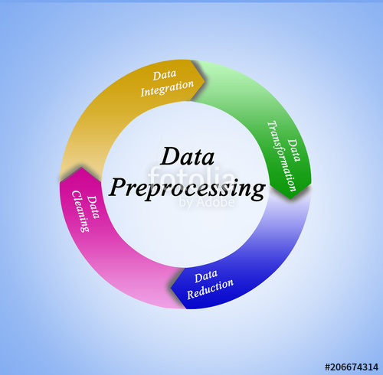
FEATURE ENGINEERING
Source: https://www.forbes.com/sites/gilpress/2016/03/23/data-preparation-most-time-consuming-least-enjoyable-data-science-task-survey-says/

Slide 6
FEATURE ENGINEERING
Data Cleaning
Exploratory Data
Analysis
… the infinite loop of data science.

Slide 7

MISSING DATA
The Missing Piece by Banksy in Vancouver

Slide 8
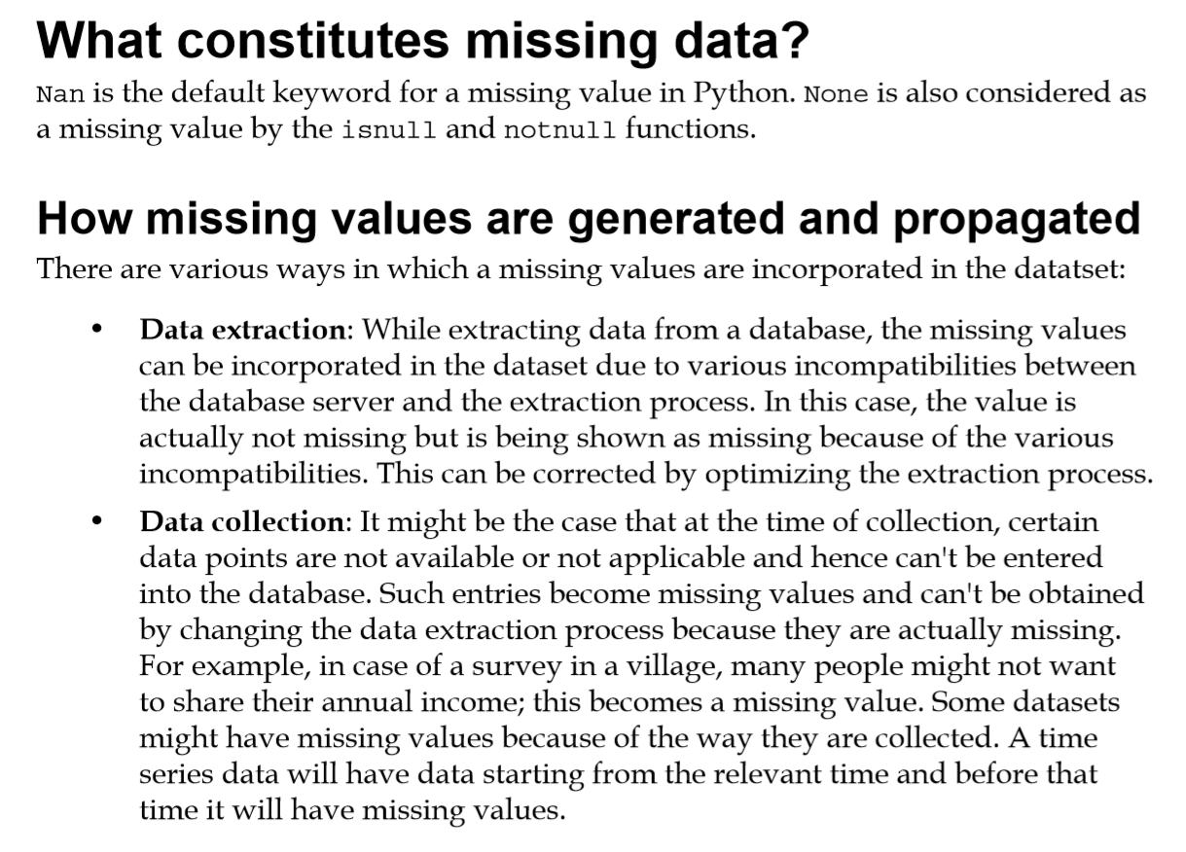

Slide 9
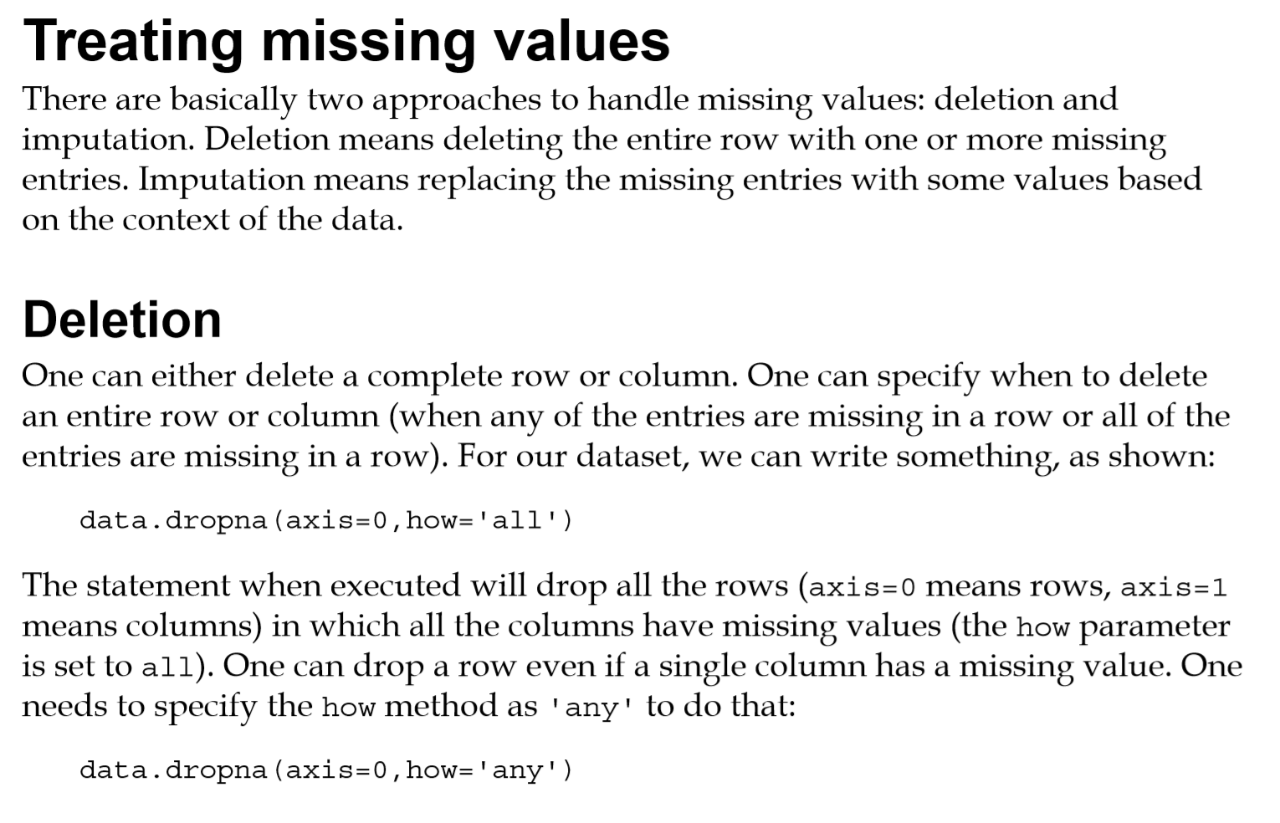
MISSING DATA

Slide 10
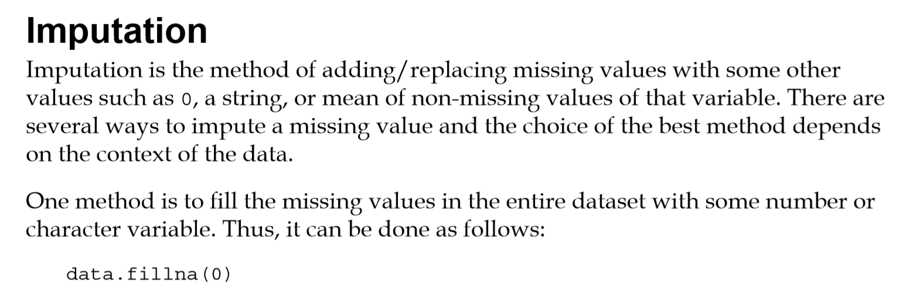
MISSING DATA

Slide 11
MISSING DATA
Numerical Imputation
Imputation is a more preferable option rather than dropping because it preserves the data size. However, there is an important selection of what you impute to the missing values. I suggest beginning with considering a possible default value of missing values in the column. For example:
If you have a column that only has 1 and NA, then it is likely that the NA rows correspond to 0. For another example, if you have a column that shows the “customer visit count in last month”, the missing values might be replaced with 0 as long as you think it is a sensible solution.
Except for the case of having a default value for missing values, I think the best imputation way is to use the medians of the columns. As the averages of the columns are sensitive to the outlier values, while medians are more solid in this respect.
Categorical Imputation
Replacing the missing values with the maximum occurred value in a column is a good option for handling categorical columns.

Slide 12
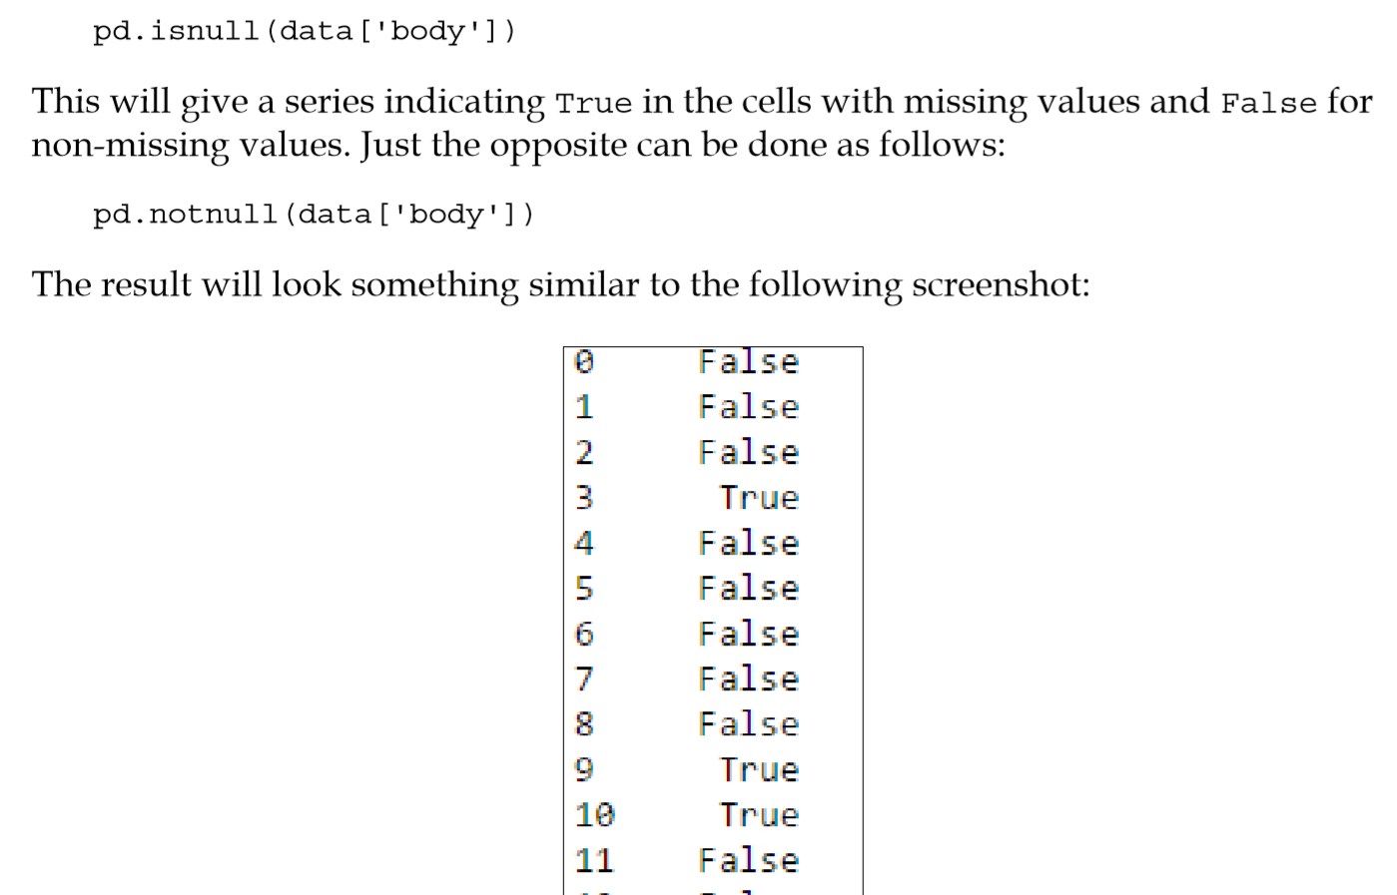
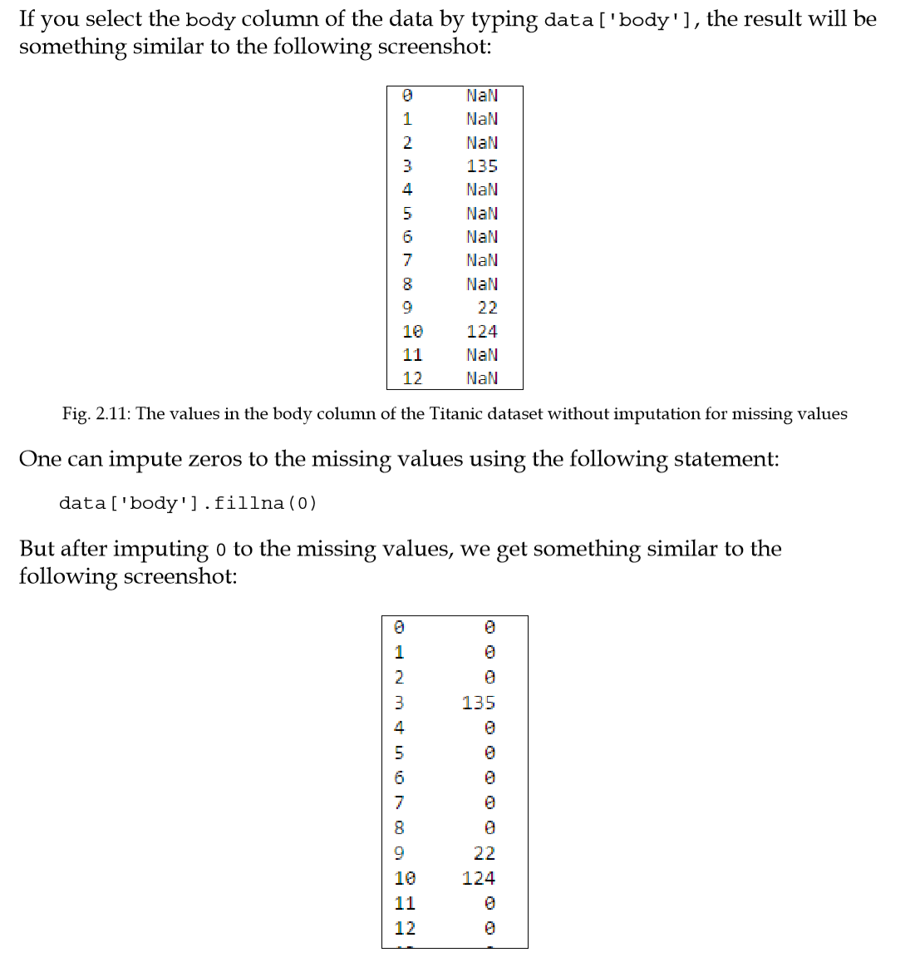
HANDLING MISSING VALUES

Slide 13
HANDLING MISSING VALUES

Slide 14
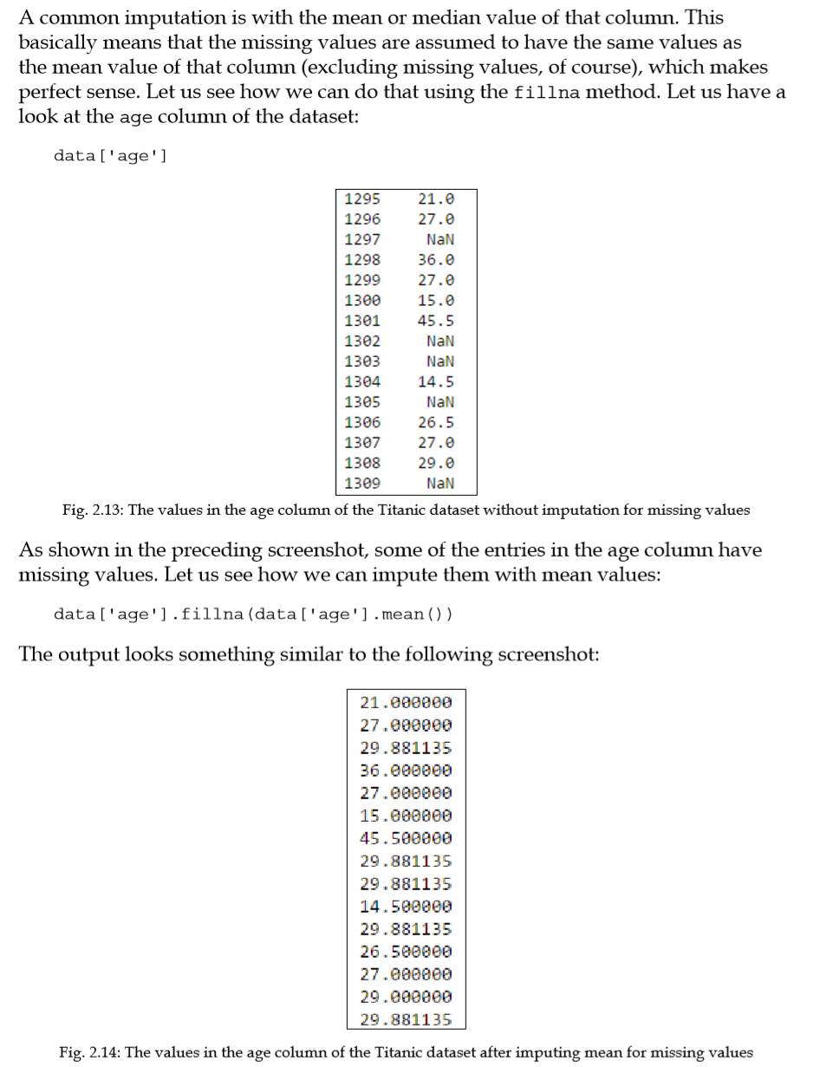
HANDLING MISSING VALUES

Slide 15
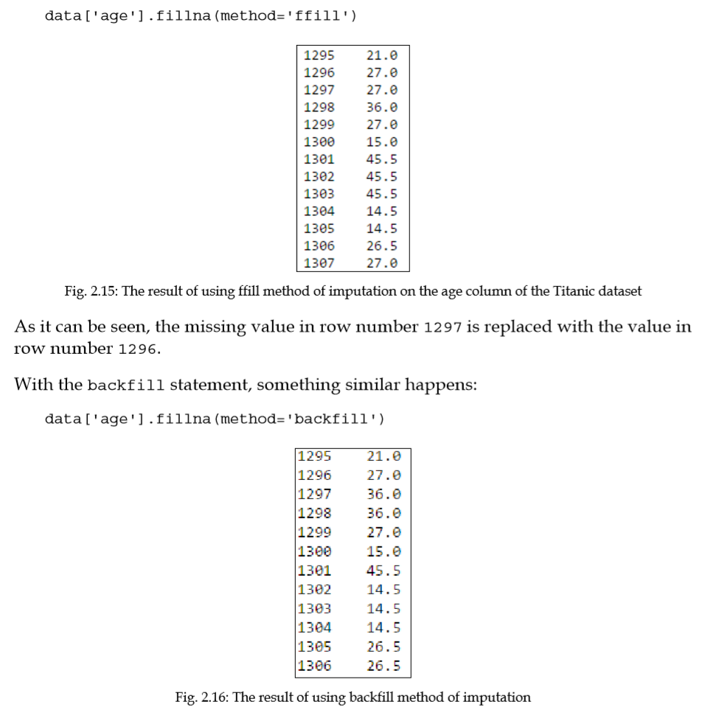
HANDLING MISSING VALUES

Slide 16
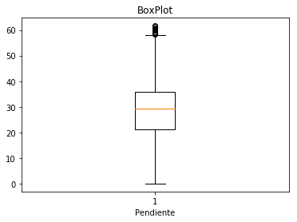
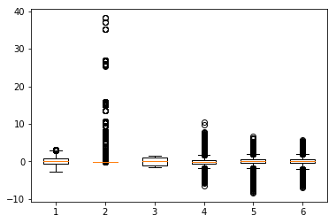
OUTLIERS
Outliers are extreme values that deviate from other observations on data , they may indicate a variability in a measurement, experimental errors or a novelty. In other words, an outlier is an observation that diverges from an overall pattern on a sample
BoXplot normalizado

Slide 17
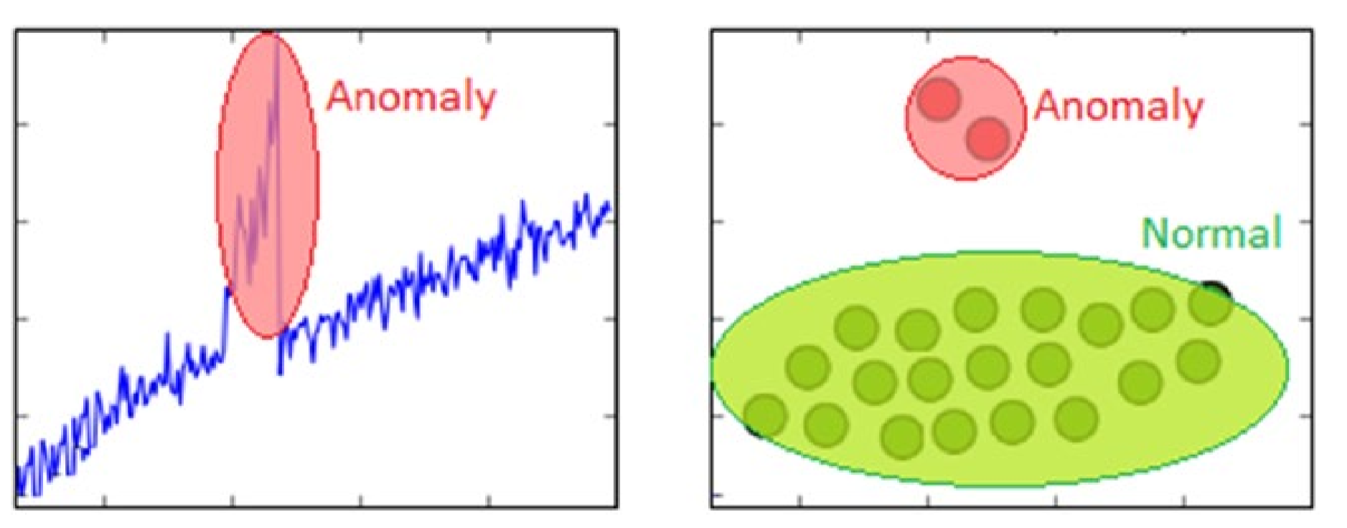
OUTLIERS
Anomaly Detection The process of anomaly detection is also termed as outlier detection, where we are interested in finding out occurrences of rare events or observations that typically do not occur normally based on historical data samples

Slide 18
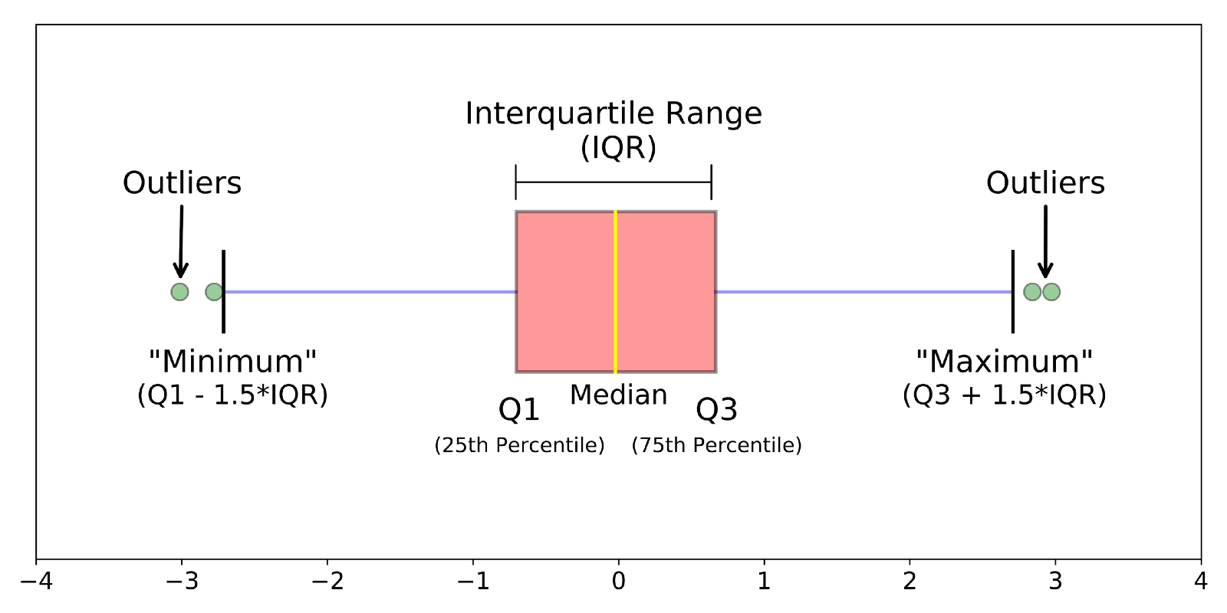
OUTLIERS

Slide 19
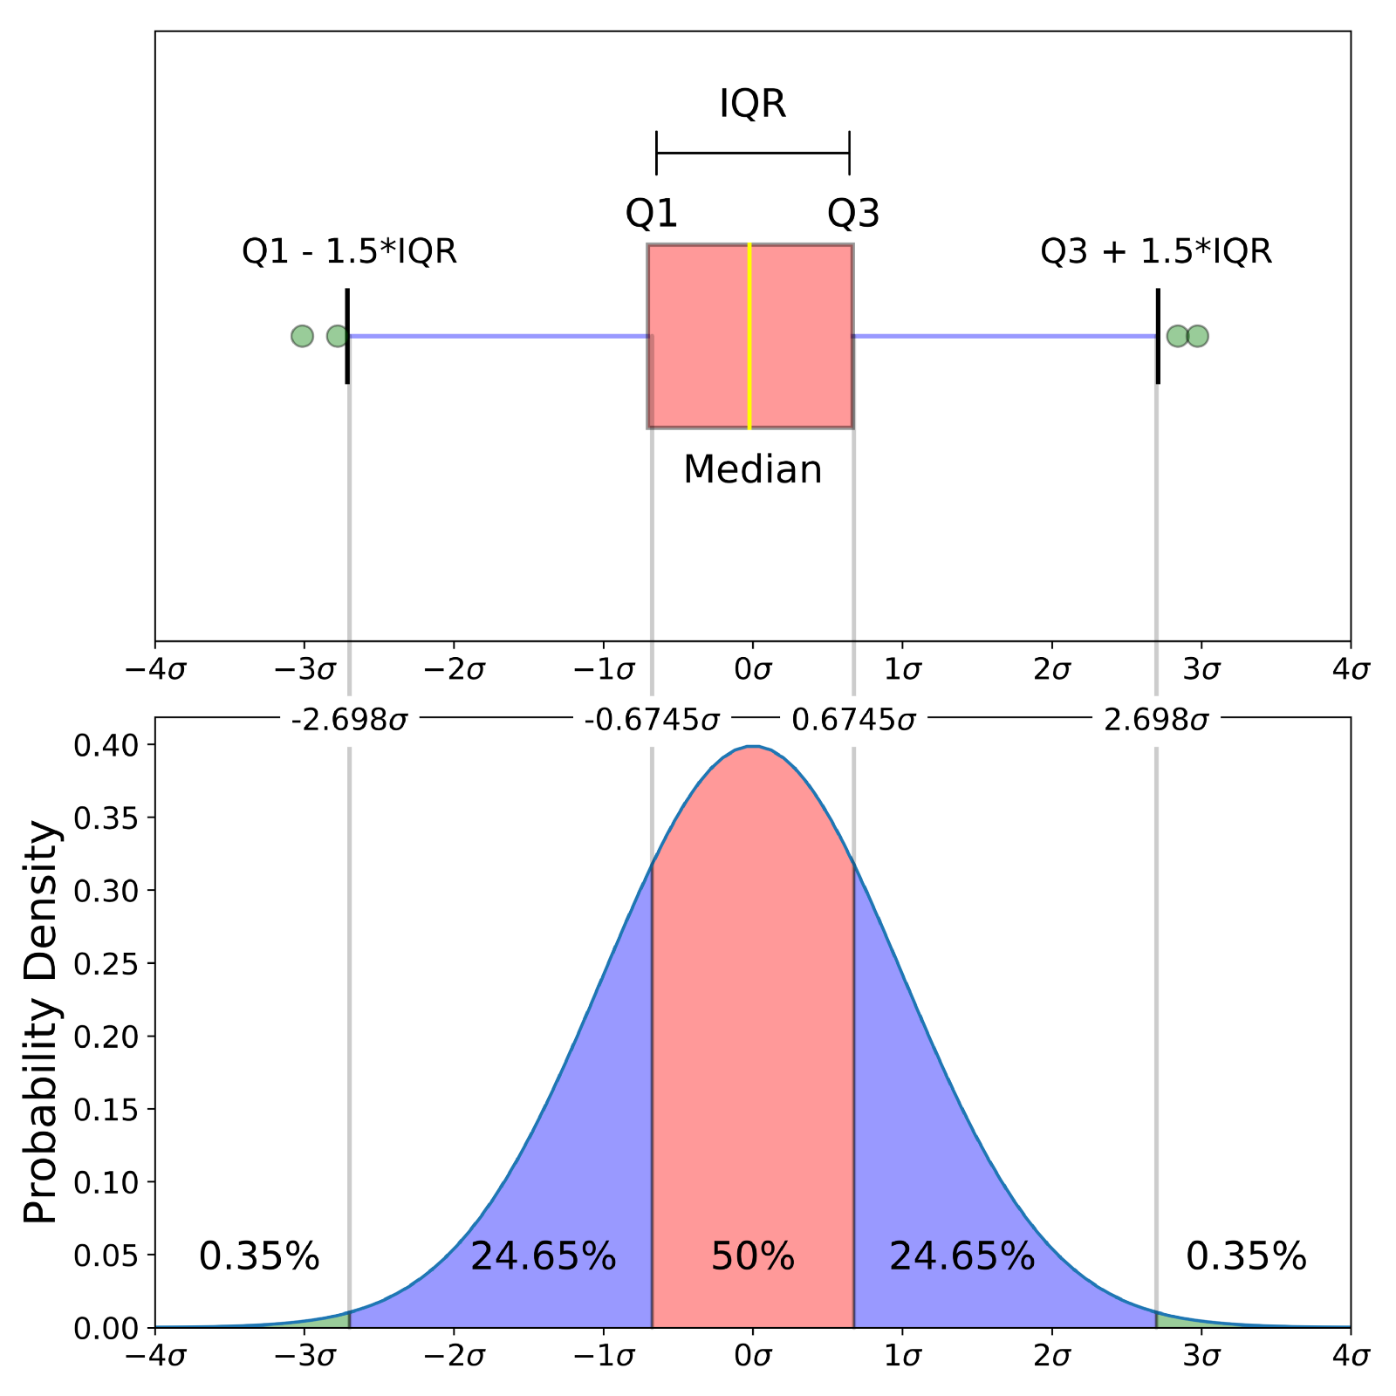
OUTLIERS

Slide 20
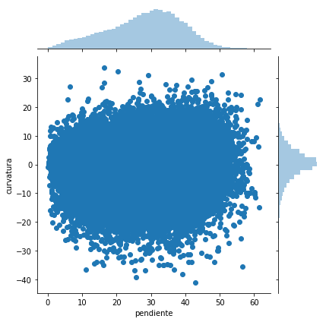
OUTLIERS

Slide 21
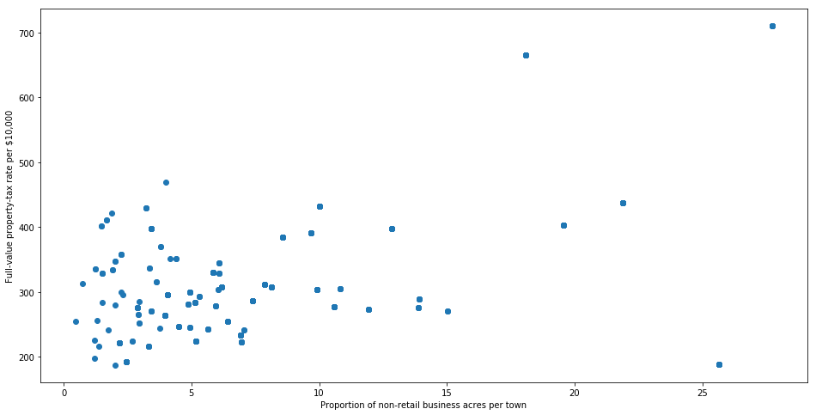
OUTLIERS

Slide 22
OUTLIERS
The best way to detect the outliers is to demonstrate the data visually. All other statistical methodologies are open to making mistakes, whereas visualizing the outliers gives a chance to take a decision with high precision.
Statistical methodologies are less precise, but on the other hand, they have a superiority, they are fast. Here I will list two different ways of handling outliers. These will detect them using standard deviation, and percentiles.
Outlier Detection with Standard Deviation. If a value has a distance to the average higher than x * standard deviation, it can be assumed as an outlier. Then what x should be?. There is no trivial solution for x, but usually, a value between 2 and 4 seems practical.
Outlier Detection with Percentiles. Another mathematical method to detect outliers is to use percentiles. You can assume a certain percent of the value from the top or the bottom as an outlier. The key point is here to set the percentage value once again, and this depends on the distribution of your data as mentioned earlier. Additionally, a common mistake is using the percentiles according to the range of the data. In other words, if your data ranges from 0 to 100, your top 5% is not the values between 96 and 100. Top 5% means here the values that are out of the 95th percentile of data.

Slide 23
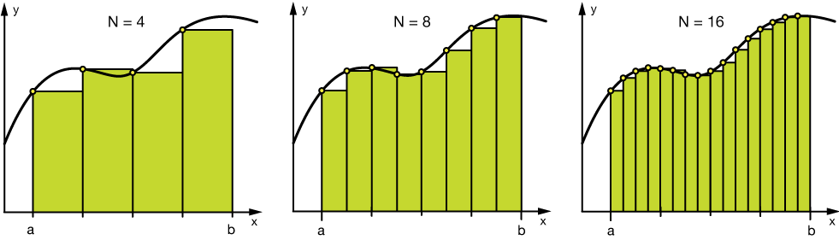
BINNING
#Numerical Binning ExampleValue Bin 0-30 -> Low 31-70 -> Mid 71-100 -> High
#Categorical Binning ExampleValue Bin Spain -> Europe Italy -> Europe Chile -> South America Brazil -> South America

Slide 24
FEATURE SCALING
Cuando se trabaja con variables numéricas, pueden existir atributos específicos con rangos de valores muy diferentes. Si se utilizan los valores crudos puede que el modelo genere errores sesgándose hacia los valores con magnitud muy grande. Los modelos lineales o regresión logística son especialmente sensibles a este problema. Los modelos basados en arboles de decisión pueden funcionar adecuadamente sin escalar las variables.
The problem of scaling is due to the fact that different input variables have different natural scales, namely their own units of measurement. For some modeling methods (e.g., classiﬁcation trees) this does not cause a problem, but other methods (e.g., distance-based methods) are very sensitive to the chosen scale of input variables.

Slide 25
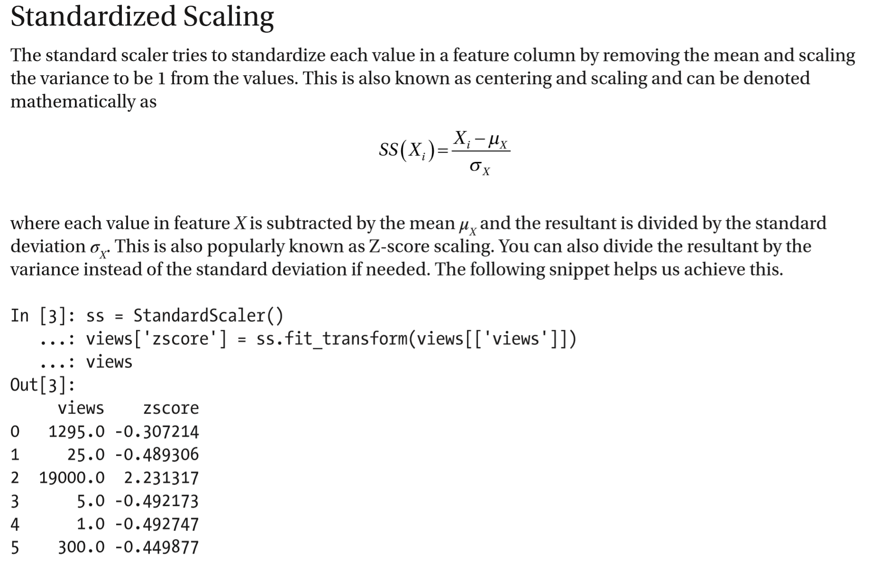

Slide 26
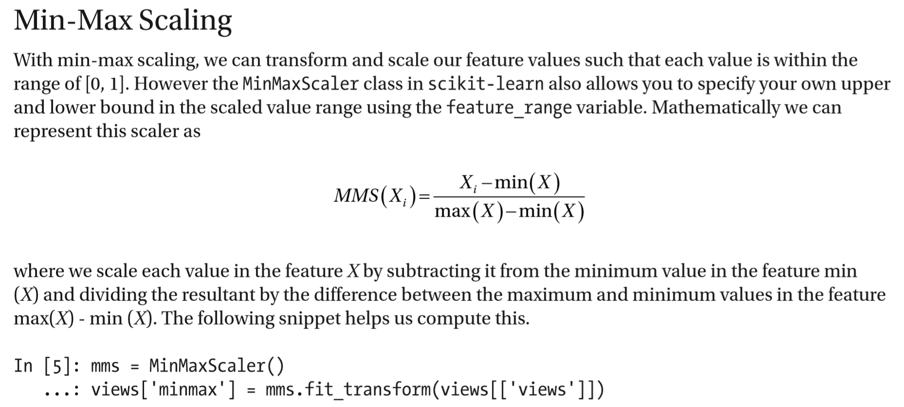
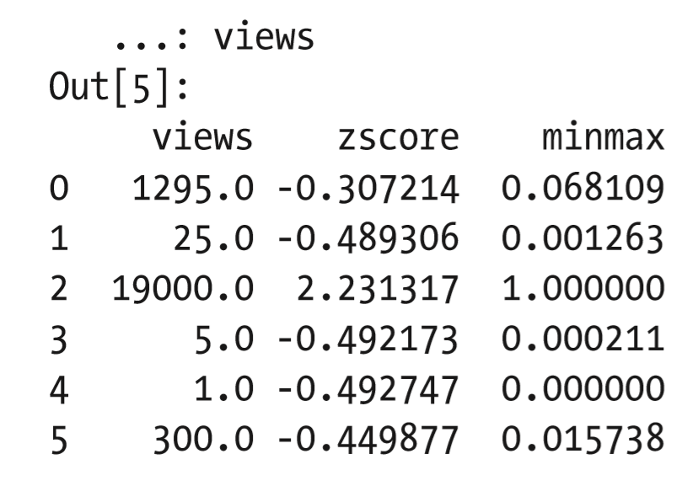

Slide 27
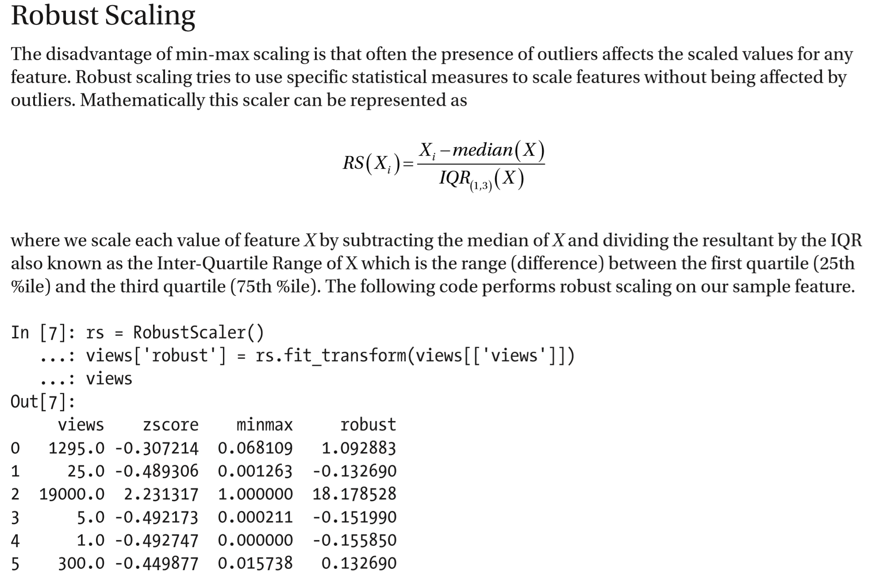

Slide 28
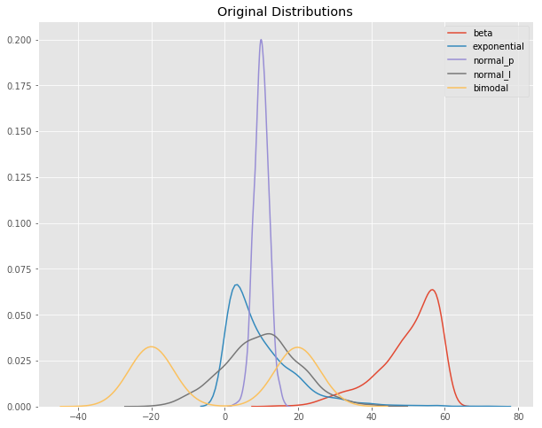
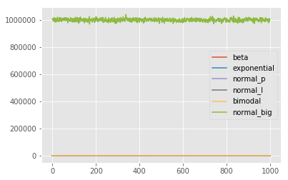
FEATURE SCALING

Slide 29
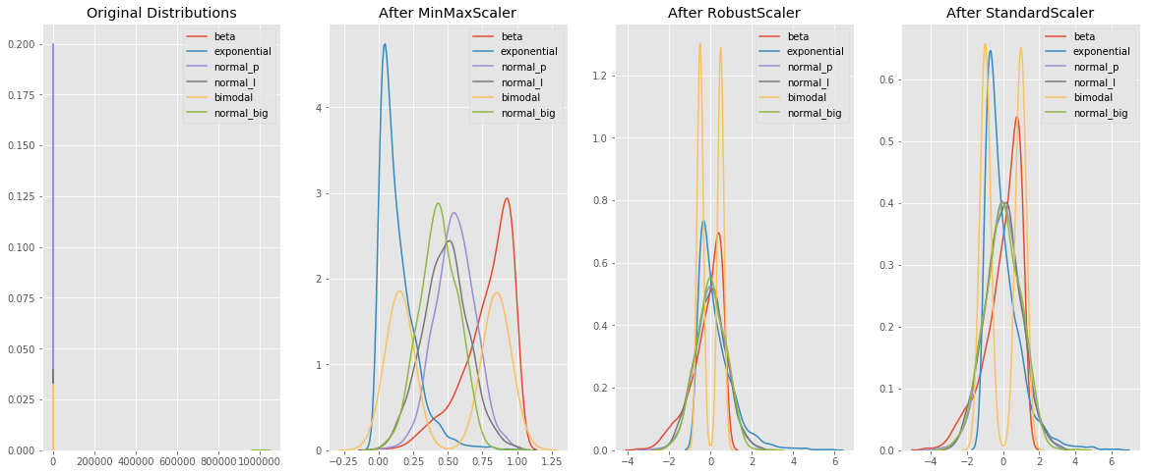
FEATURE SCALING

Slide 30
VARIABLES CATEGÓRICAS
Some algorithms can work with categorical data directly.
For example, a decision tree can be learned directly from categorical data with no data transform required (this depends on the specific implementation).
Many machine learning algorithms cannot operate on label data directly. They require all input variables and output variables to be numeric.
In general, this is mostly a constraint of the efficient implementation of machine learning algorithms rather than hard limitations on the algorithms themselves.
This means that categorical data must be converted to a numerical form.

Slide 31

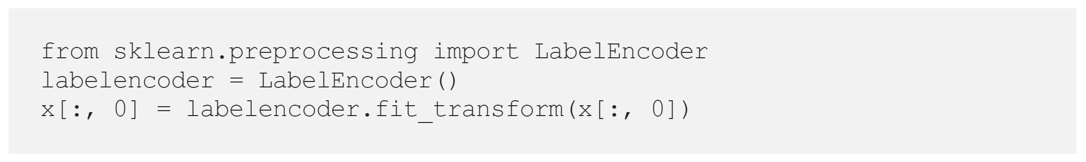
LABEL ENCODING
Label encoding assigns each unique value to a different integer.
NOTA: using this encoding and allowing the model to assume a natural ordering between categories may result in poor performance or unexpected results

Slide 32
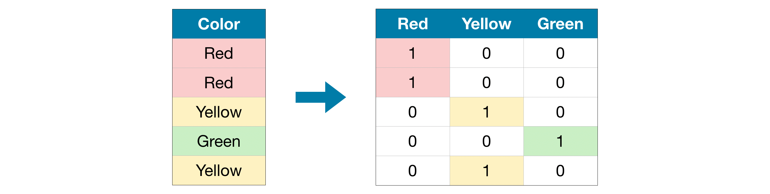
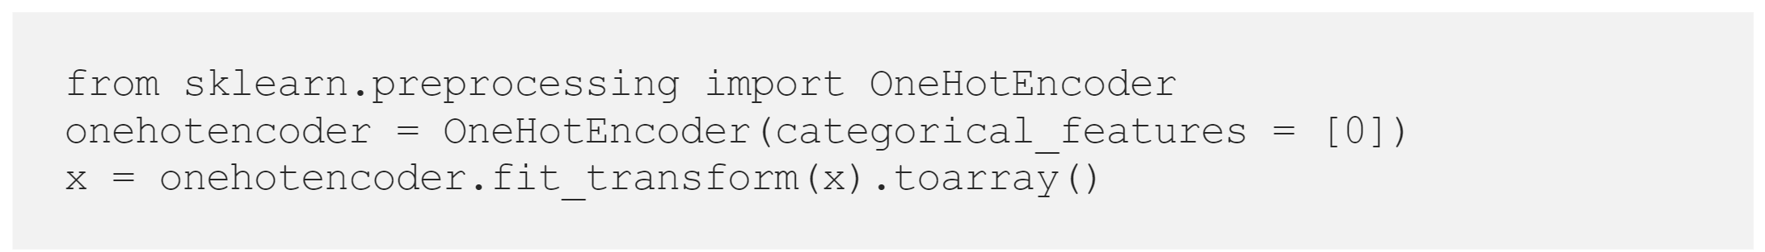
ONE-HOT ENCODING
For categorical variables where no an ordinal relationship exists, the integer encoding is not enough.
One-hot encoding creates new columns indicating the presence (or absence) of each possible value in the original data. To understand this, we'll work through an example.

Slide 33
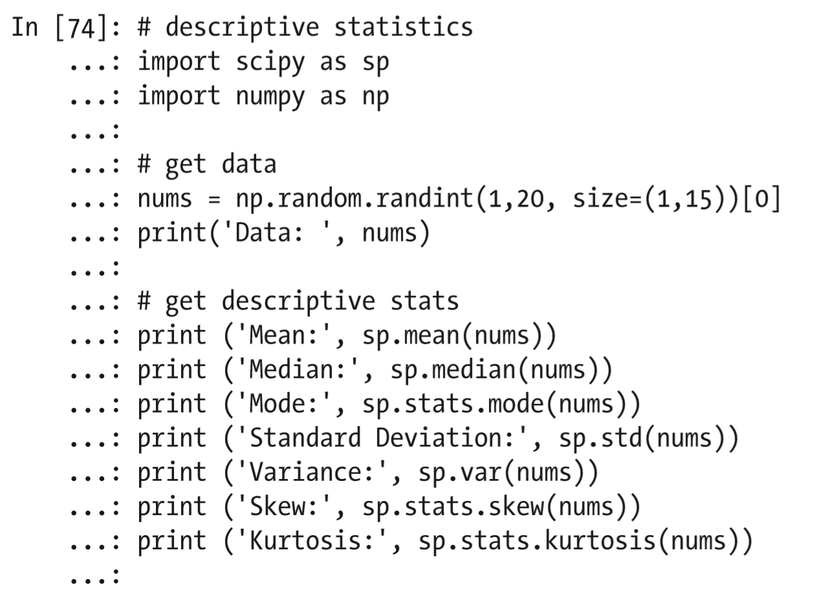
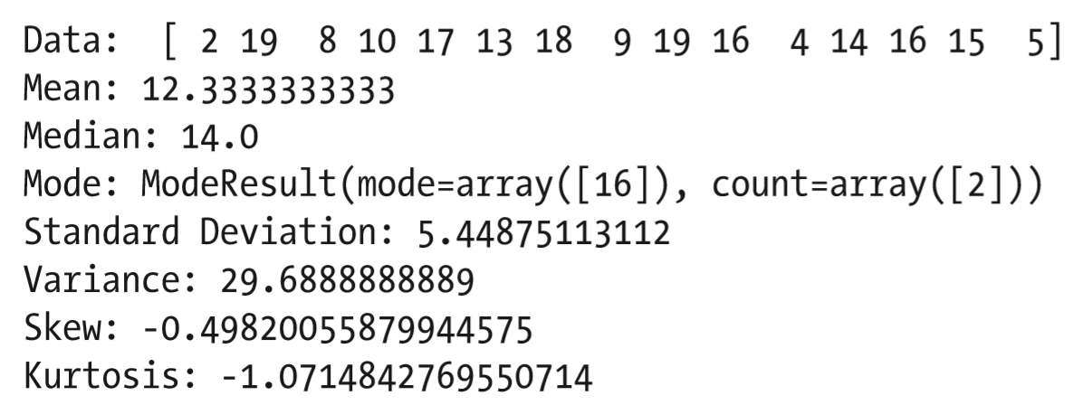
ESTADÍSTICA DESCRIPTIVA

